Slide 1

Focus on Teaching and Learning
Actionable Tools for Student Engagement
Alyssa Burns, Avery Smith, Marianna Swallow & Tim Reynolds
August 2021

Slide 2
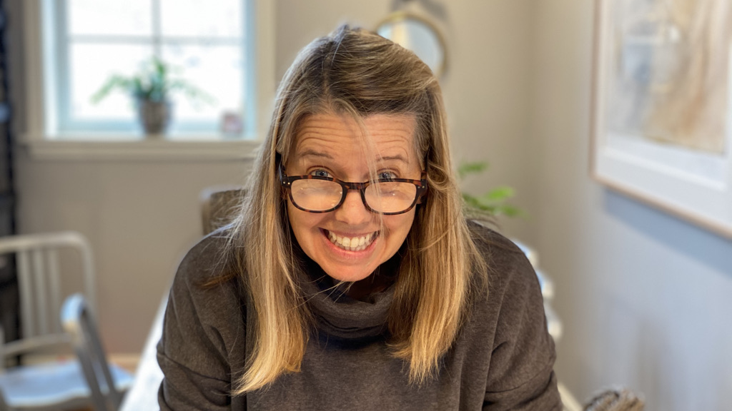

Slide 3
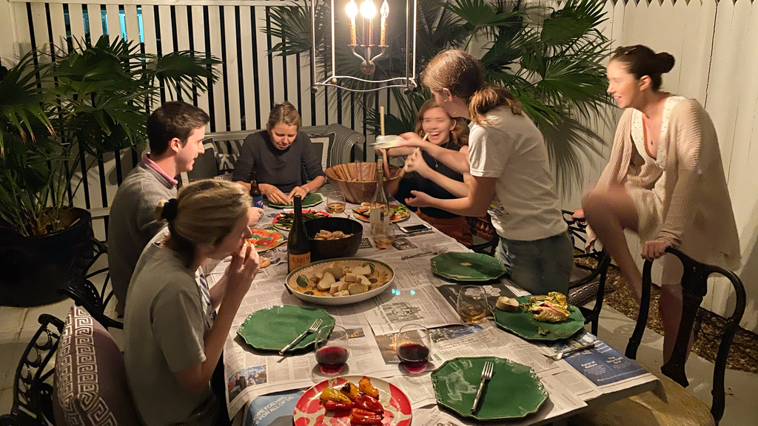

Slide 4
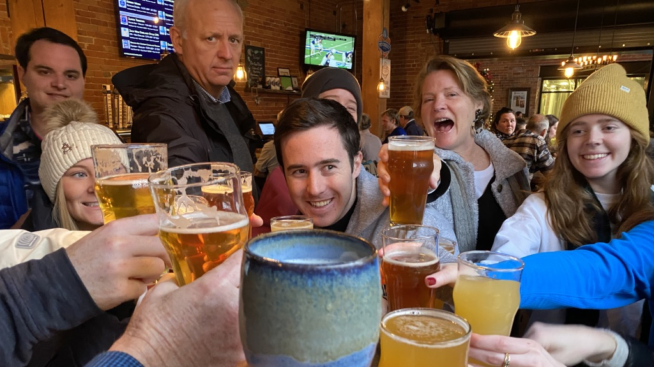

Slide 5
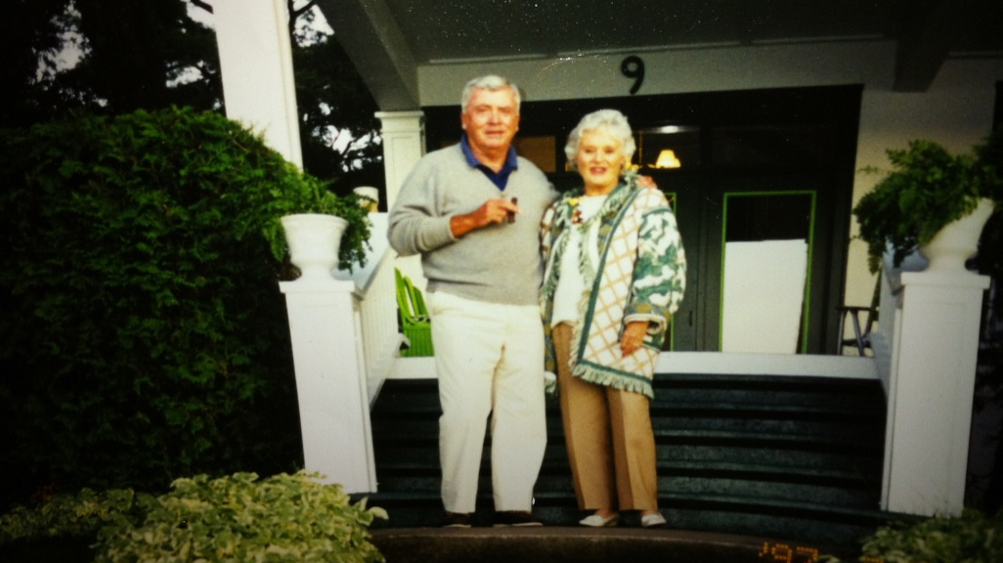

Slide 6


Slide 8
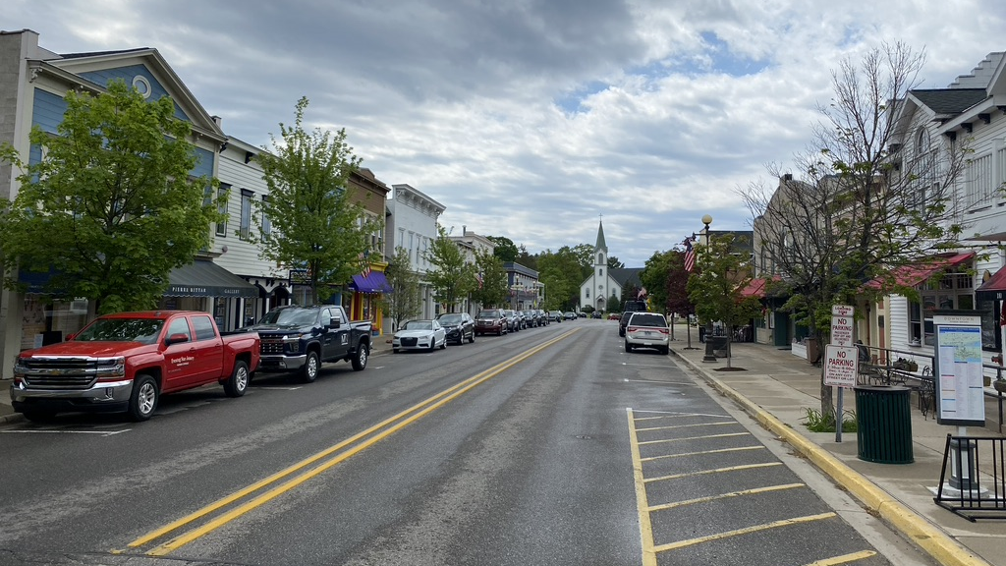

Slide 9


Slide 10
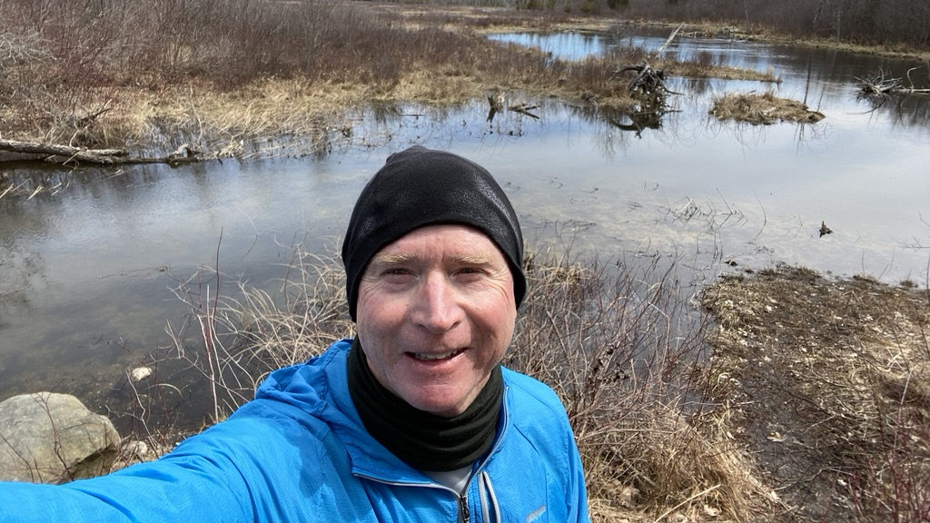

Slide 11


Slide 13

How do you want to make your students feel?

Slide 14
What are your small things?

Slide 15


Slide 19
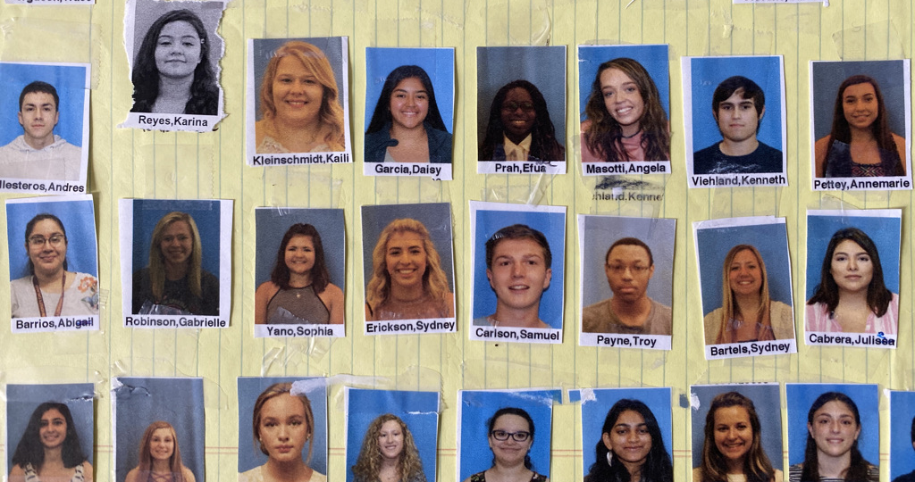

Slide 20


Slide 23
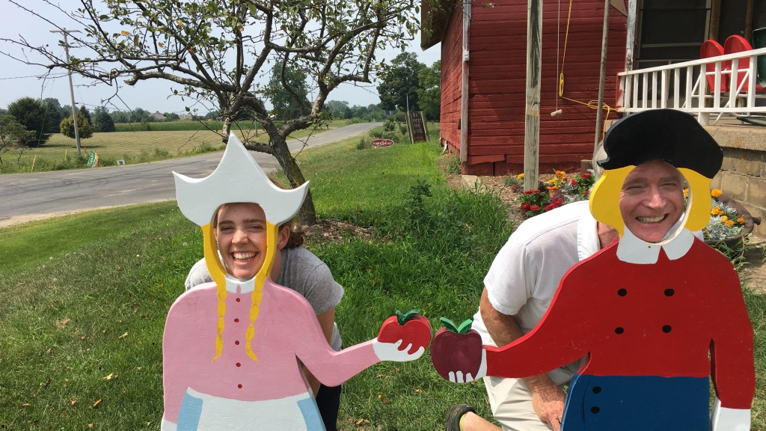

Slide 24
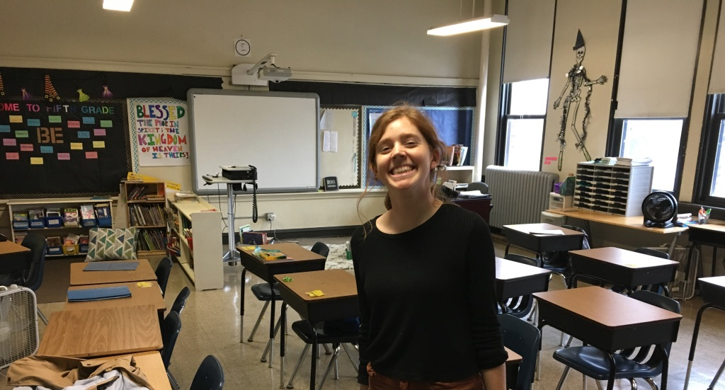

Slide 25
Small actions can have a big impact
Tell students you consider it a privilege to teach at LUC and this class
Promise to teach how to think, not what to think
Have students make their own rules of engagement
Learn every student’s name
Ask a general question during roll call
Have current events segments
Randomize breakouts
Show you are human that you have a sense of humor, make mistakes
Care

Slide 26
Actionable tools for student engagement
Greet
Ask
Listen
Reveal

Slide 27
Greet
Ask
Listen & Reveal
“Good morning/Good Afternoon!”
“How are you doing?” (“What is on your mind?”)
Wait for and listen to their response.
Let the students know how you are today.

Slide 28
Easy-to-Use Tools for Zoom or in the Classroom aka: What we did to keep students engaged and what we’re taking back into the classroom.
Prof. Alyssa Burns
Public Relations Writing, Principles of PR, Principles of Advertising, Ethics & Communication, Business & Professional Speaking
Prof. Marianna Swallow
Business & Professional Speaking, Interpersonal Communications
LOYOLA UNIVERSITY CHICAGO FOTL 2021

Slide 29
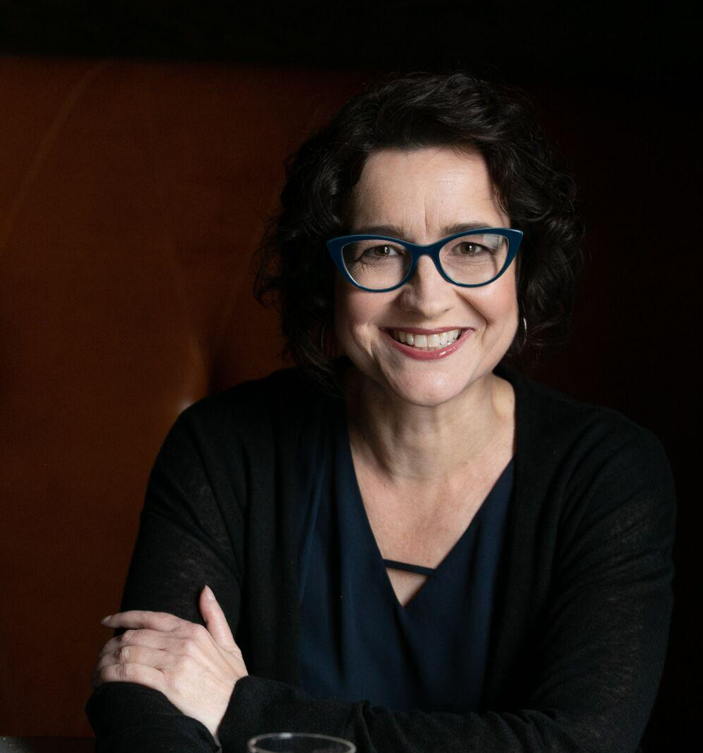

Marianna Swallow
Workshop Maven @
M. Runge & Associates
Workshop leader since 1998
Improv & Theater
Horrible Ukulele player

Slide 30
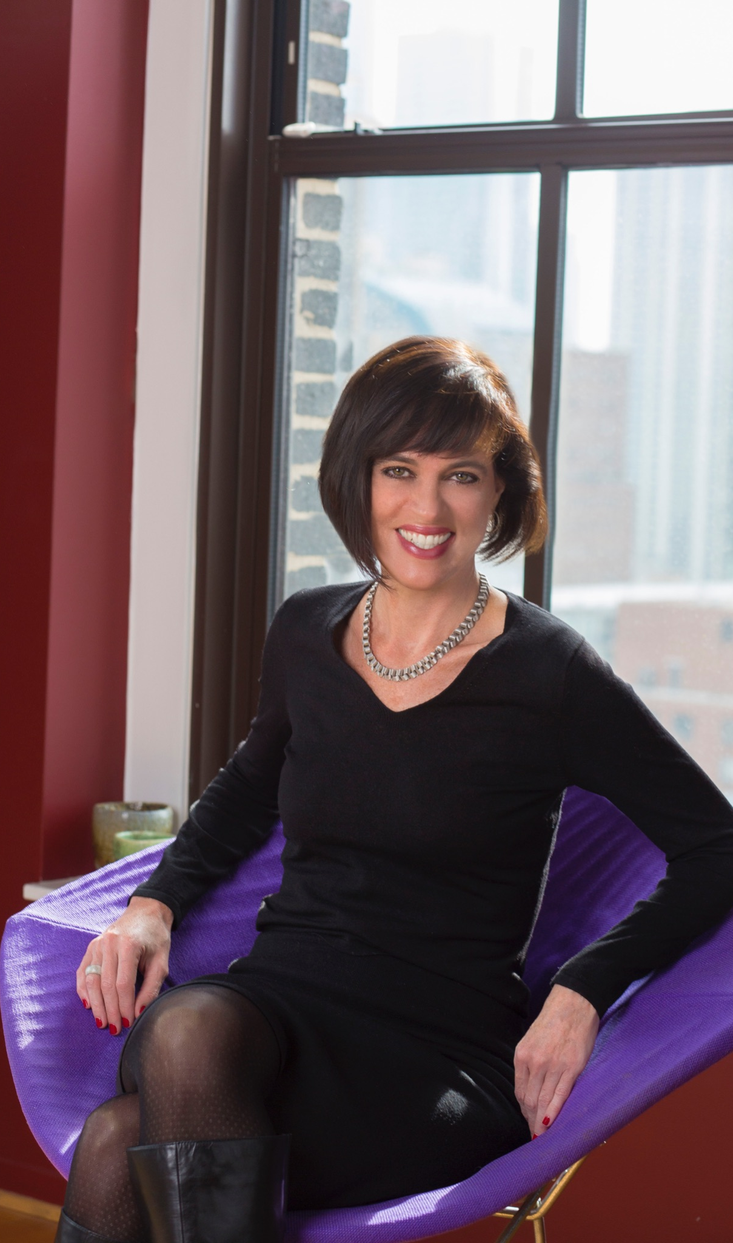

Alyssa Burns
Alyssa Burns Communications: Woman-owned business since 2013
Communications experience at Kraft Foods and Edelman Worldwide
Travel Adventurer!
Learned how to speak Italian after a chance encounter on La Tour Eiffel 🇫🇷

Slide 31

Why this is important

Slide 32
  Students on Zoom all day
  Looked forward to class because it was interactive
  An opportunity to show I care

Slide 33
  College did not prepare me for work-world
  Lecture, lecture, lecture =
  awful, awful, awful
  Engaged learning is
  effective learning

Slide 34
Tips For Zoom

Slide 35
Ways we use the chat
Icebreakers
To give each other feedback
To field questions for class + guest speakers
To learn what slang the kids are using

Slide 36
The latest slang
15:22:19 From Alex Samas to Everyone : K vs. kk vs. ok vs. okay
15:22:32 From Grace White to Everyone : When they say lol
15:23:02 From Alex Samas to Everyone : Lol DOES NOT mean Lots of Love
15:23:03 From Eliana Jacobsen to Everyone : My dad thought that meant lots of love for so long, he would be like ‘I’ll be back on Monday lol”
15:25:35 From Angela Salonga (she/hers) to Everyone : “K”
15:25:39 From Sophie Blanchard to Everyone : K. = bad
15:25:42 From Bridget Schulte to Everyone : 100%
15:25:49 From Grace White to Everyone : I hate k.
15:25:50 From Donnalee Huddleston to Everyone : K. will be the death of me

Slide 37
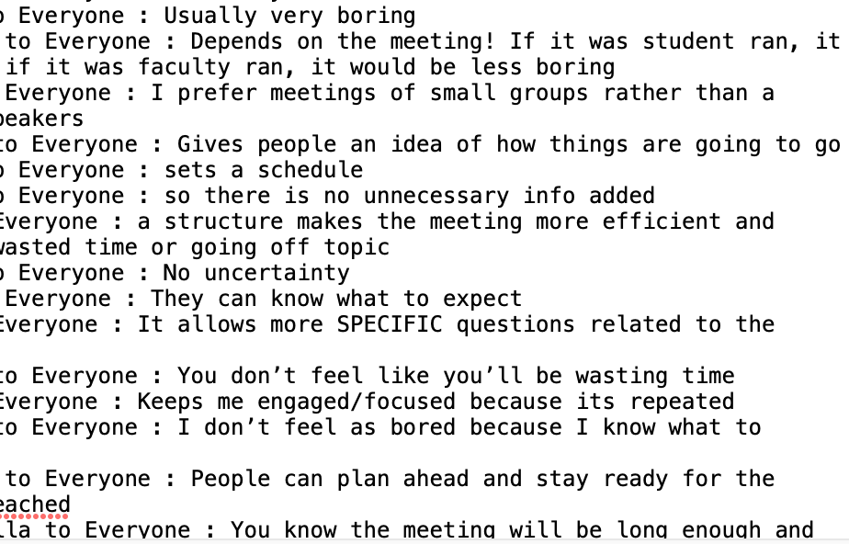
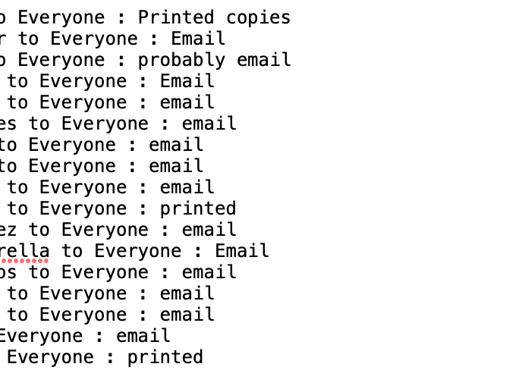
Debrief or Surveys
Q: DO YOU PREFER A MEETING AGENDA TO BE EMAILED OR PRINTED FOR YOU?
Q: WHAT DID YOU LIKE ABOUT LEARNING FROM EACH OTHER?
Notes:
Check for Learning
I also used it as a way to keep attendance – they had to chat “hello” upon arrivl.

Slide 38
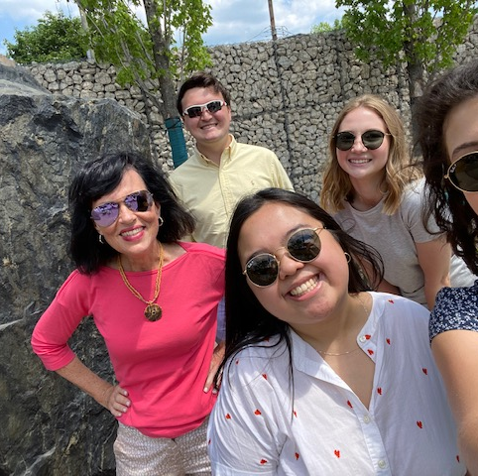
Interactive = Engaging
“There was never a ‘boring’ class! Professor Burns engaged us with conversation, asking our POV on things and always kept the chat section lively by encouraging us to say what’s truly on our minds. Good conversations and quality chats carried this class.”
-A. Salonga, rising senior

Slide 39

“What’s happening in the news?”

Slide 40
Classroom management over Zoom
Give clear instructions:
“Say your name, then pass to someone else.”
Write instructions to self:
Benefit: To remember what to cover
and not miss anything
Notes:
directives for guest speakers, asking questions, pvt chat (AB)
directives for interactivity activities (ms)

Slide 41
Icebreakers for Zoom & IRL
The meeting method that keeps on giving

Slide 42
Major Differences
Zoom
Give instructions to keep moving
On-screen & verbal
Say [whatever]
Pass to someone else
IRL
Stand up
Say [whatever]
Sit down when you’re done
– or –
Choose who goes next/sit down
Notes:
“sitting is your reward for talking”

Slide 43
3 Favorites

Slide 44
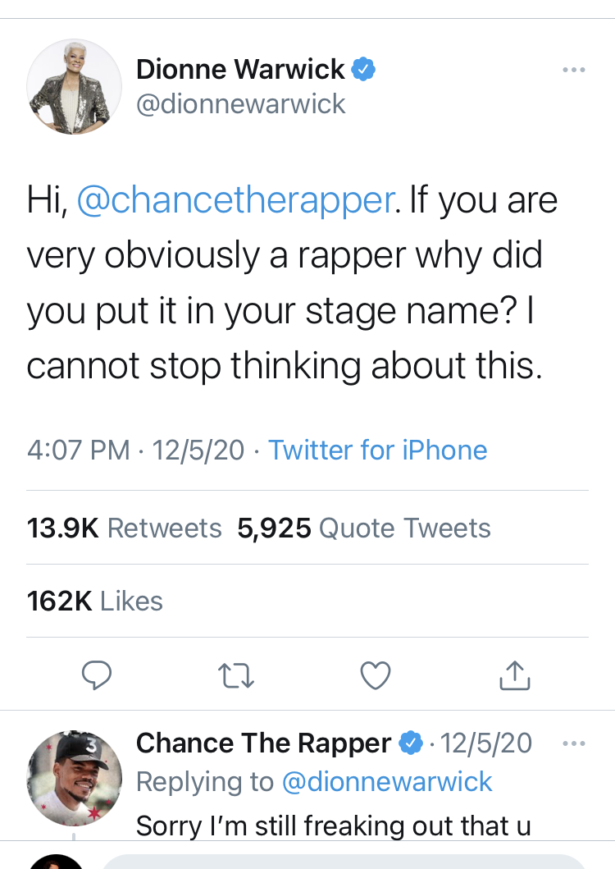
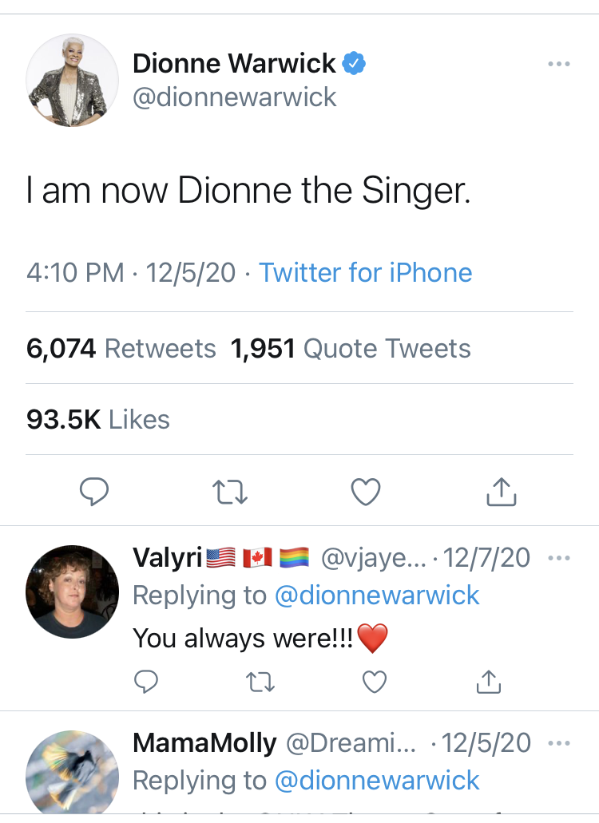
Tell us something about you in Chance the Rapper format
Can not be
“the student”
Pass to someone else
Notes:
SAY DIFFERENCES IN IRL VS. ZOOM

Slide 45
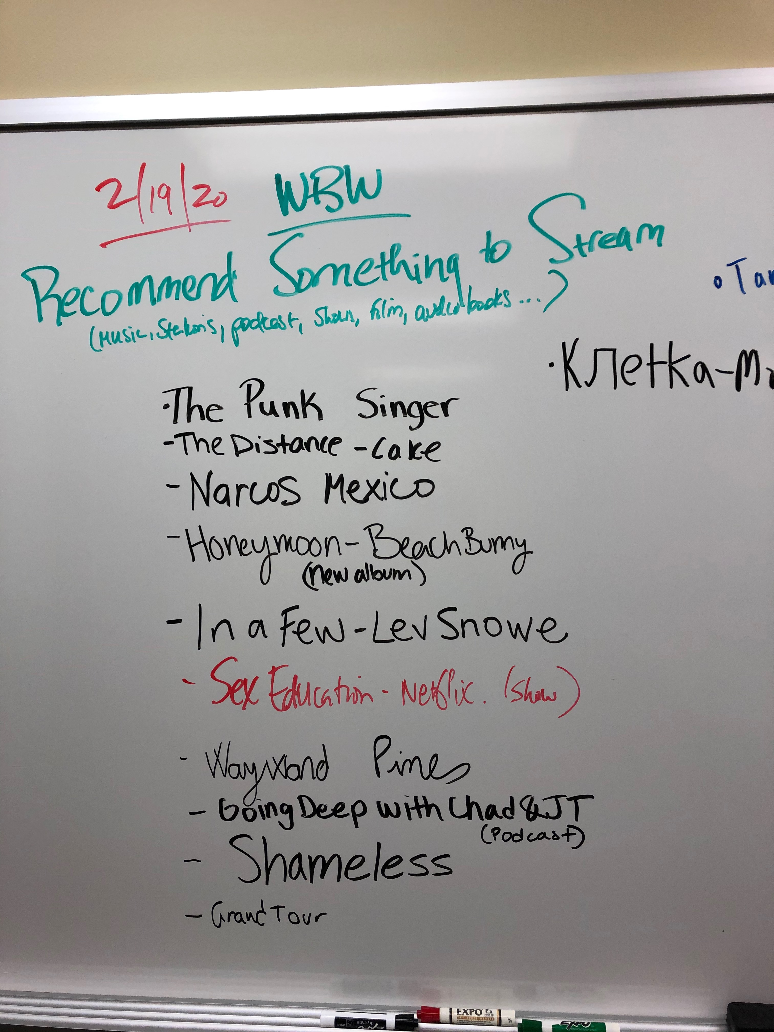
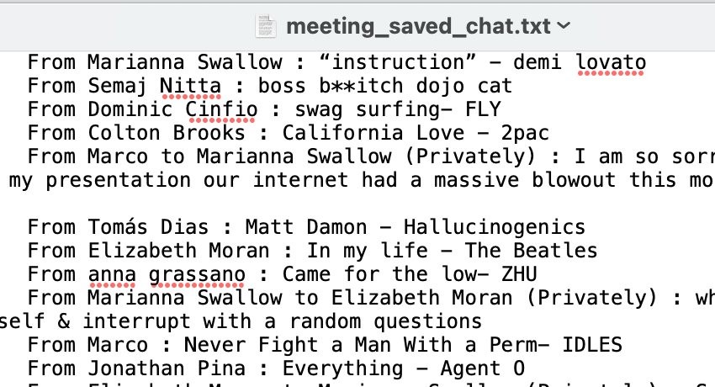
Whiteboard Wednesday
QUESTION: What’s Your Walk-On Song?
Notes:
ms: find 3000 questions book to show/hold up

Slide 46
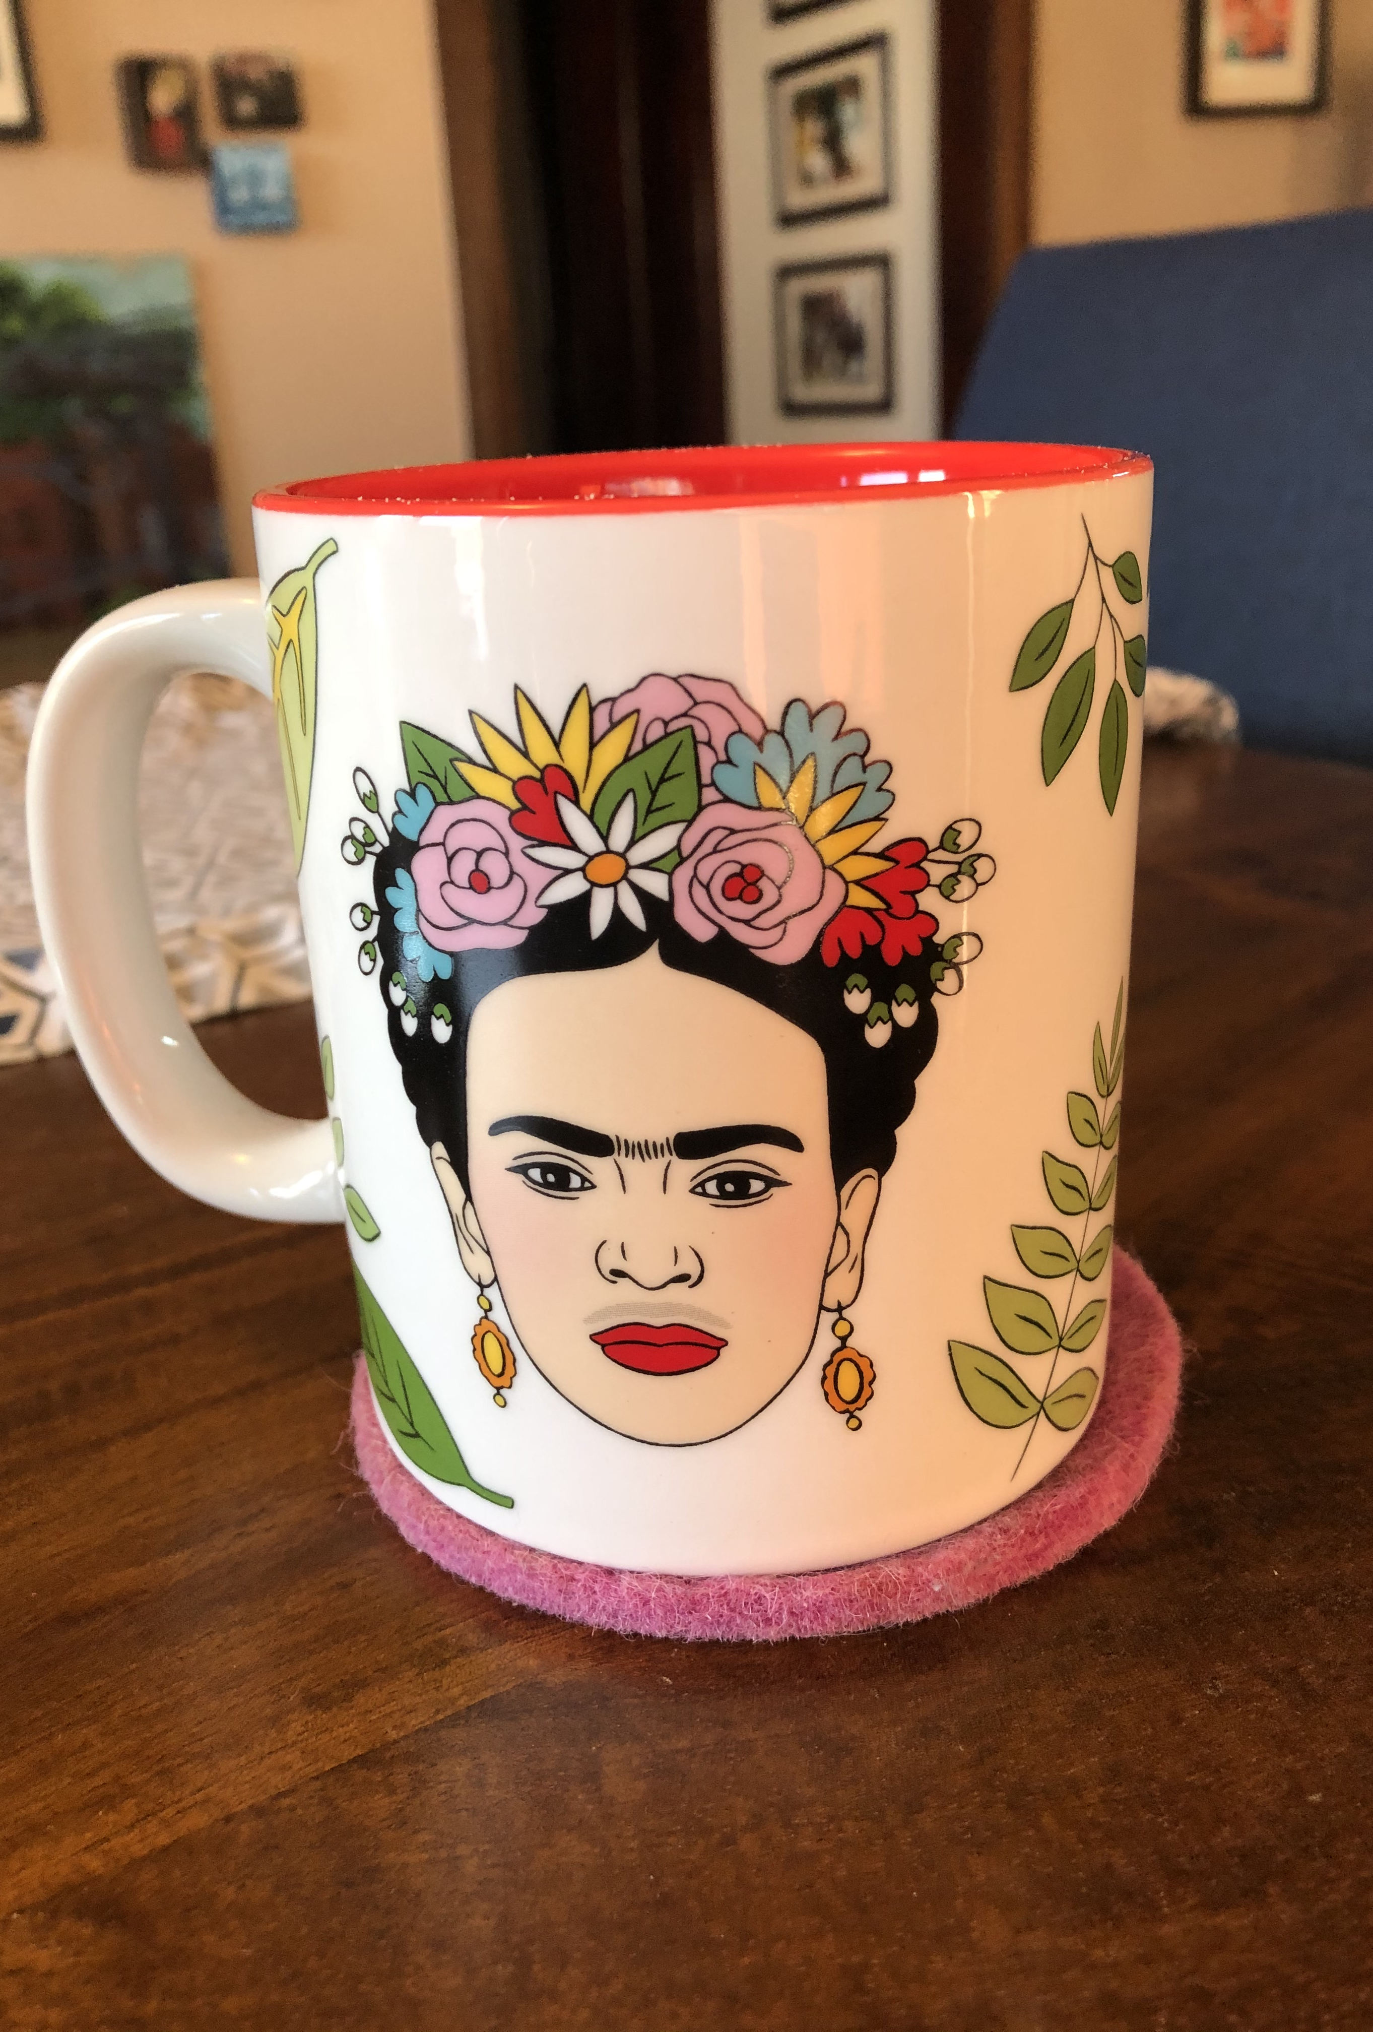
“Show Us Something”
Zoom
Time limit
Find X, come back & show us
IRL
Bring something in
Create something in class

Slide 47
Tips For In Person
…and what translates from Zoom to Real life

Slide 48
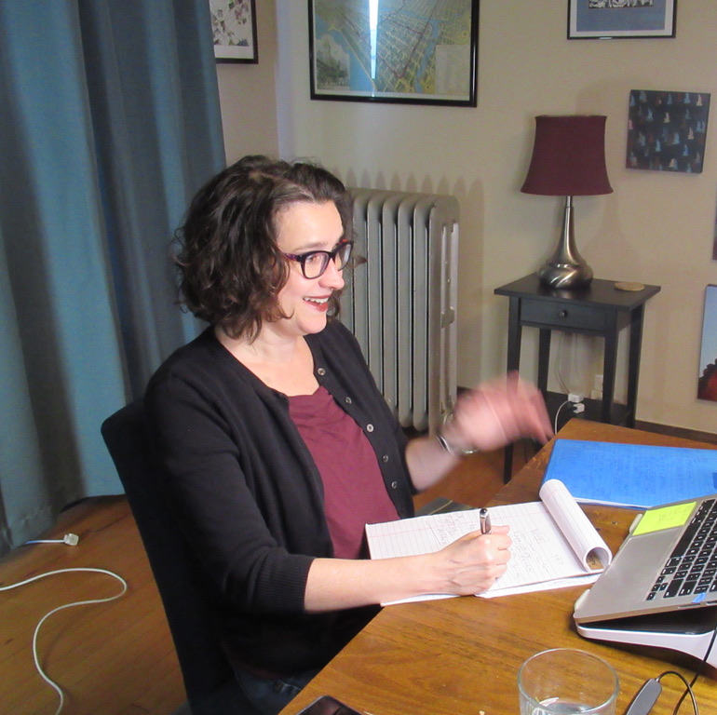
Involve
Students
The more you can involve them, the better.
Here’s what we do.

Slide 49

Students Want to Hear from Each other.
Not 100% Professor.
Introduce each other
  Teach backs
Notes:
What I learned from them last sem – they enjoy it more when it comes from each other – not necc. a teacher.
One feedback I got from students in the final was they loved hearing about the documentaries from EACH OTHER and not me. “More relatable when it comes from students.”
PS: THIS GIVES YOU A CHANCE TO SEE IF THEY’R ELEARNING THIS STUFF + GET A BIT OF A BREAK!!!

Slide 50

“Ask the Professor”

Slide 51

The One Minute Paper
Write down the three key things you learned in today's lecture
Was there a confusing point in today's class?
How useful was the group exercise that we did in class today?

Slide 52

Crisis Situations in Real Time
Following trends in the news
Use my past crisis experience

Slide 53
Recap –
What did we learn?
Which of these methods
will you try?
What’s one thing stood out to you?

Slide 54

Thank You
Alyssa Burns | Marianna Swallow
alyssaburnscommunications.com
mariannaswallow.com
or on LinkedIn:
/mariannas
/alyssaburns2

